Slide 1



Evaluation with aSQA
2
ATAM or aSQA
Iterations
Scores
Notes:
ATAM (Architecture Trade-off Analysis Method) is heavy. aSQA (arch. software quality assurance) has iterative focus.
With aSQA. Easier to directly compare different suggstions.
We had two iterations: before and after improvement.
Some scored based on prototype. Rest are guesstimates. 1-5 from the literature.
Metrics were hard to define for guesstimates.
Two main modules. 3 components in first iteration. 2 in second.

Slide 2
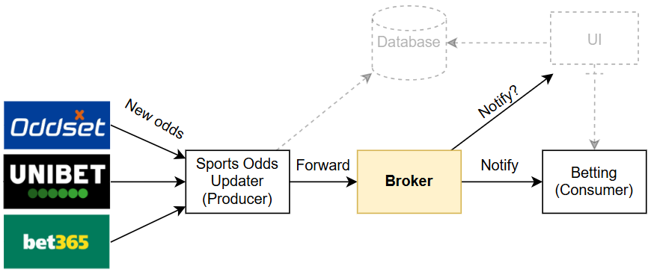
The broker
Global Odds Broker → Trigger Order Broker
Performance (target 3)
1 → 2
Modifiability (target 2)
1 → 1
Safety (target 2)
1 → 1
Notes:
Global to trigger orders only.
The hidden trade-off. Now UI updates must be handled else-wise
Lower importance because it happens before users bet for money.

Slide 3
The Betting Kernel
Actor Model → Load Balancer →
Load Balanced Actor Model
Performance (target 5)
Modifiability (target 4)
Safety (target 4)
2 → 5 →
5
5 → 4 →
3
4 → 1 →
4
Notes:
The initial tradeoff: Safety vs Performance.
The new trade-off. Performance and safety has higher importance. Lower modifiability
Higher importance than broker because this is where users place money

